Slide 1
Overview of U.S. Immigration What You Need to Know for Your Business to be up to Speed
Jacki@lentinivisas.com
www.lentinivisas.com

Slide 2
U.S. Government Agencies
Department of Homeland Security (DHS)
U.S. Citizenship and Immigration Services (USCIS)
Customs and Border Protection (CBP)
Immigration and Customs Enforcement (ICE)
Student and Exchange Visitor Information System (SEVIS)
Department of State (DOS)
US Embassies and Consulates – issues visas
Oversees certain visa categories (J-1)
Department of Labor (DOL)
oversees H-1B visa with the Labor Condition Application (LCA)
involved in green card through employment process

Slide 3
Nonimmigrant – Temporary Immigrant - Permanent
Nonimmigrant visas are for foreign nationals coming temporarily to the US for a specific purpose (tourism, study, work, etc.) and for a specific period of stay as designated on the I-94 record.
Immigrant visa is for the green card process based on employment, a family relationship, diversity visa lottery, or as an asylee/refugee. Individuals are permitted to remain in the US indefinitely and work for any employer in the US. Can pursue the green card process while working in the US on a non-immigrant visa, but may have issues with travel abroad for certain classifications that do not permit immigrant intent (ex. TN, F-1)

Slide 4
H-1B: Specialty Occupations
Specialty occupation (position must require Bachelor’s degree in specialty & beneficiary must have the degree in that specialty);
Quota imposed on the H-1B category by Congress;
If selected in lottery & approved, starts on Oct. 1 of that year
Valid for a maximum of 6 years (in 3 year increments), but can extend if employer starts green card process
Time outside the US does not count and can be recaptured
Dual intent permitted
Prior to filing an H-1B petition with USCIS, employer must first obtain a certified Labor Condition Application (LCA) from the Department of Labor

Slide 5
Visa Categories for Temporary Employment
Type Number per fiscal year
E-3, Specialty Occupations for Australians 10,500
H-1B1, for Chileans 1,400
H-1B1, for Singaporeans 5,400
No quotas for the following:
Treaty NAFTA (“TN”) for Mexican and Canadian nationals
J-1, Professor & Research Scholar
O-1, Extraordinary Ability or Achievement
L-1, Intracompany transferee
E-1/E-2, Treaty Trader/Investor

Slide 6
F-1 Student Employment
Curricular Practical Training (CPT) – short-term employment authorization during degree program; employment must be integral to the established curriculum; often used for summer internships
Optional Practical Training (OPT) –
Employment must be related to degree program
Most often done at the end of one’s degree, but other options are available especially for grad students
12 months of employment after each consecutive higher degree
Requires DSO recommendation and USCIS authorization
May apply 90 days before completion of degree and up to 60 days after
STEM OPT extensions for certain fields of study

Slide 7
STEM Optional Practical Training
STEM - degrees in Science, Technology, Engineering and Math. The complete list of STEM approved degrees for OPT extension purposes is listed at http://www.ice.gov/sevis/students/
STEM OPT extensions may only be for employment at an employer enrolled in E-Verify
A STEM OPT extension application should be filed with USCIS 90-120 days prior to the expiration of the student’s current OPT
Employment may continue for up to 180 days beyond the current EAD card expiration with a timely filed STEM OPT application
May apply only once for a STEM extension.

Slide 8
L-1: Intracompany Transferee
Companies must have proper corporate relationship to be a qualifying organization
New Office situation
Blanket L-1
At least ten L-1 approvals in the past year;
U.S. sales of at least $25 million; or
U.S. work force of at least 1,000 employees
One out of previous three years of employment abroad for foreign national
L-1A manager or executive
L-1B specialized knowledge

Slide 9
E-1/E-2: Treaty Trader & Treaty Investor
Treaty of commerce or navigation or bilateral investment treaty
Qualifying under the treaty (company ownership)
Nationality of the employee or principal
Treaty Trader- substantial trade principally with the U.S.
Volume of trade
Number of transactions
Continued course of trade
Treaty Investor
Active and substantial investment
No maximum length of time to remain in the U.S.

Slide 10
Visa Options for Permanent Employment
EB-1: Extraordinary Ability, Multi-national Executive or Manager, Outstanding Researcher
EB-2: Professional with an Advanced Degree, National Interest Waiver, Exceptional Ability
EB-3: Professional or Skilled Worker
EB-4: Special immigrants such as reacquisition of citizenship, Religious workers
EB-5: Investor program

Slide 11
What is Form I-9, Employment Eligibility Verification
Form I-9 is used for verifying the identity and employment authorization of individuals hired for employment in the United States.
All U.S. employers must ensure proper completion of Form I-9 for each individual they hire for employment in the United States. This includes citizens and noncitizens. Both employees and employers (or authorized representatives of the employer) must complete the form.
On the form, an employee must attest to his or her employment authorization. The employee must also present his or her employer with acceptable documents evidencing identity and employment authorization.
The employer must examine the employment eligibility and identity document(s) an employee presents to determine whether the document(s) reasonably appear to be genuine and to relate to the employee and record the document information on the Form I-9.
Employers must retain Form I-9 for a designated period and make it available for inspection by authorized government officers

Slide 12
What is an SSA No Match Letter?
A written notice issued by the Social Security Administration (SSA) to an employer, usually in response to an employee W2, advising that the name or Social Security number (SSN) reported by the employer for at least one employee does not "match" a name or SSN combination reflected in SSA's records.
The letter cautions employers against taking any adverse employment action against the employee based solely on receipt of the letter, and explicitly states that the letter makes no statement about the employee's immigration status.
The letter simply reports an apparent error in either the employer's records or SSA's records, and seeks the employer's and, if necessary, the employee's assistance in conforming those records.
Why are they coming now?
Government announced in late 2018 that they would begin issuing the “no match” letters again starting in Spring 2019. They began issuing the letters in March 2019.
The prior letters (Bush era) had the names of the employee and the SSN at issue on the original letter that was issued to the Company.
New letters provide information on how to go onto the Business Services Online (BSO) to retrieve the no-match names so that you and the employee can correct the errors and submit any necessary corrections on the Form W2-C within 60 days of receipt of the letter.

Slide 13
What agencies does the letter potentially impact?
13
Interplay between SSA and the Department of Homeland Security(DHS)/Immigration and Customs Enforcement (ICE):
SSA – views the letters as a wage reporting/benefit issue. SSA’s intent is to maintain accurate earning records so that it can properly process benefits for people who request SSA benefits.
DHS – enforces the US immigration laws including compliance with the Form I-9 and fines (which can include fines for constructive knowledge of employing employees who are not authorized to work in the US)
DHS in the past as part of a Form I-9 audit has requested copies of the employer’s no match letters.

Slide 14
What do Companies need to do with the letter?
(1) Do Nothing - ? – SSA does not have the ability to fine an employer for not complying
However SSA is not the worry, DHS is! If you do nothing, especially under the current administration, DHS could find that a reasonable person would not have acted in that manner and done nothing. Through a Form I-9 audit, DHS could charge the company with constructive knowledge which can result in fines and potential criminal action.
Different attorneys have different experience and can have differing legal opinions.
The “do nothing” option imposes significant risk.
DHS is increasing their audits and is more aggressively seeking criminal actions (based on conversations we have had during current Form I-9 audits with DHS)
My advice is the same advice supported by the Society of Human Resource Management
An ICE agent was asked her opinion on “doing nothing”… her response, I can’t understand why any employer would ignore the letter.

Slide 15
What do Companies need to do with the letter?
(2) Log on to the BSO, register and obtain the no-match names.
The portal will give you the no-match names and last 4 digits of the SSN.
Then go through a non-discriminatory process of addressing the no-matches with each employee on the list.
Do not terminate/discipline/suspend any employee solely on the basis that their name is on the no-match list.

Slide 16
Cost/Benefit Analysis of Registering and Obtaining the Names
If you don’t obtain the names and do nothing, you risk being audited by ICE and incurring fines (or criminal action) for constructive knowledge.
The SSA letter tells you to login and get the information. You would have to explain to ICE why you got this letter and choose to ignore it or chose to follow a plan of action that did not include getting the information SSA told you to obtain to determine the information that does not match.
Under this administration ICE/DHS are only increasing their enforcement efforts and they don’t have sympathy for companies that don’t comply (or give the hint they had knowledge or were trying to shortcut the law).

Slide 17
Timeframes
The Department of Justice has indicated in prior guidance you must give the employee a “reasonable period of time” to address a no match letter.
“[t]here are no Federal statutes or regulations in effect that define a ‘reasonable period of time’ in connection with the resolution of a no-match notice. As a practical matter, a ‘reasonable period of time’ depends on the totality of the circumstances. Of note, in the E-Verify context SSA has the ability to put a tentative non-confirmation into continuance for up to 120 days. This recognizes that it can sometimes take that long to resolve a discrepancy in SSA’s database.” (https://www.justice.gov/sites/default/files/crt/legacy/2010/12/29/FAQs.pdf ).

Slide 18
Timeframes
The Department of Justice guidance for the “reasonable period of time” relates to giving a person who says “that is my SSN and SSA has made a mistake” time to address that with SSA.
If the person tells you that is not their number and they cannot go to SSA to get a new one. The employer can no longer employ that person because you have knowledge the SSN does not relate to that person and you no longer have the ability to report wages for that employee because you know the SSN they gave you is not valid. This employee would not get 120 days “try to get a new number”.

Slide 19
Constructive or Actual Knowledge
Actual Knowledge – If they tell you they are not authorized to work in the US, you cannot continue to employ them.
Constructive Knowledge - If you have knowledge through talking to the employee about the SSA no match letter that establishes the person is not authorized to work in the US then you can’t continue to employ them.
ICE/DHS and a court will look to the circumstances surrounding the particular situation and use a standard of what is reasonable (what a reasonable person would do/know) to determine if an employer should have known that an employee was likely not authorized to work in the US.

Slide 20
I-9 Audits – Internal How to prepare
Employers need to ensure compliance so that they do not incur fines or penalties. A careful sample audit is a great way to see how well the process is going in your company in a timely and budget-friendly manner.
A careful sample audit involves reviewing a sample of the I-9 forms to see if they are properly documented and if not, understanding the risk the company has and what it could do to mitigate that risk.
Samples must be taken objectively, such as with an alphabetic algorithm, and executed faithfully. Any unclear documents uncovered during the audit are also governed by strict rules of protocol for investigation.
Why do a sample audit? If you have a large workforce where it is difficult to ensure that all employees are documented properly, a sample audit can:
Mitigate your company’s risk of fine or other penalties. In extreme cases, top managers can be personally liable and a sample audit hedges that risk;
Uncover misunderstandings or inconsistencies in your company’s process which can be managed better than if uncovered by Immigration and Customs Enforcement (ICE).
Generate goodwill and reduce damages in the event of an ICE audit. If you can show that your company has done a sample audit and has trained workers annually to execute the process correctly, ICE is more likely to assess lower fines for violations they uncover.
Receive a professional, careful internal audit. This ensures your organization is in compliance and to steer clear of civil and criminal penalty risks.

Slide 21
Questions?
Domande?
¿Preguntas?
Fragen?
问题 ?
Vragen?
Вопросы?
سوالات ?

Slide 22
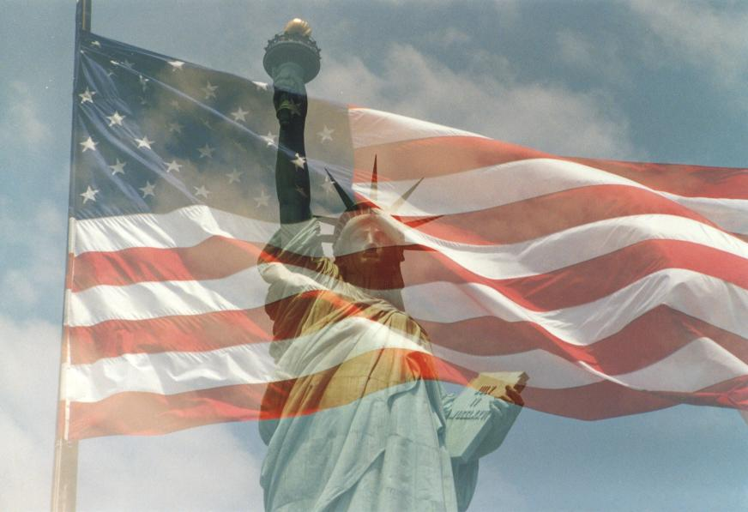
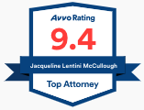
Thank you for your time
Contact Jacqueline Lentini, jacki@lentinivisas.com
+630-262-1435
www.lentinivisas.com
Notes:
jacki@lentinivisas.com
630-262-1435
22

